Slide 1
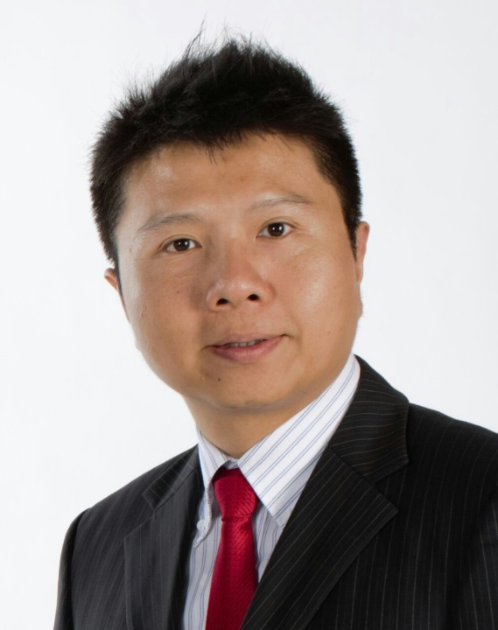
超連鎖™事業致勝關鍵
UnFranchise™ Business The Key to Success
Calvin Chiang
顧問經理級
Supervising Coordinator
四個佣金週期共賺取HK$57,500
HK$57,500 in 4 Commission weeks
本簡報中提到的收入等級純屬舉例說明，無意代表美安香港超連鎖™店主的一般收入，也無意表示任何超連鎖™店主皆可賺取同等收入。美安香港超連鎖™店主的成功與否，取決於其在發展事業時的努力、才能與投入程度。The income levels mentioned in the following presentation are for illustration purposes only. They are not intended to represent the income of a typical Market Hong Kong UnFranchise ™Owner, nor are they intended to represent that any given Independent UnFranchise ™ Owner will earn income in that amount. The success of any Market Hong Kong Independent UnFranchise ™ Owner will depend upon the amount of hard work, talent, and dedication which he or she devotes to building his or her Market Hong Kong Business.

Slide 2




幸福人生Happy Life

Slide 3



理想Dream

Slide 4


現實 Reality

Slide 5
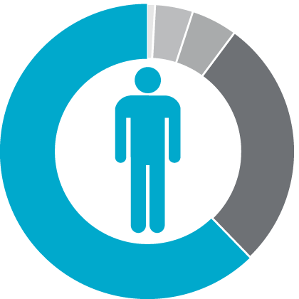
在年滿65歲的每100個人中…
For every 100 people who should have reached the age of 65...
4%財務穩健Financially Fit
1%富有Wealthy
5%仍在工作
Still Working
62%貧窮／身無分文
Struggling Financially
28%
已逝世 Dead

Slide 6

現實 Reality

Slide 7
人生就是選擇的累積
Life is created by the cumulative choices
選擇
choice
選擇
選擇
choice
choice
選擇
選擇
選擇
choice
選擇
choice
choice
選擇
選擇
選擇
choice
選擇
choice
choice
選擇
選擇
選擇
choice
choice
choice
choice

Slide 8
用消費的概念來創業
Build Your Own Business by Converting Spending into Earning
打工收入
Salary
投資Investment
儲蓄
Savings
支出 Expenses
超連鎖™事業UnFranchiseTM Business
SHOP.COM
『購物年金』Shopping Annuity

Slide 9








集結眾人的努力
鼓勵團隊合作和支援
人人皆享100%的銷售和業績成果
Compounding efforts
Encourages teamwork
and support
Everyone receives 100% credit for sales
and volume generated
所有成員彼此競爭ALL IN COMPETITION
房地產、保險、連鎖店、區域業務員／經理
Real Estate, Insurance, Franchise, Regional Sales/Manager
Notes:
9

Slide 10

累積 Accumulate

Slide 11


